Slide 1
Dr Craig French

Slide 2
Anaemia is bad for you.
BUT
Is correction of anaemia with
Red Blood Cell transfusion good for you?

Slide 3
In medical patients, what is the effect of RBC transfusion on patient outcomes?

Slide 5
52 year male
Presents with acute myocardial infarct to a large city hospital
He receives thrombolysis therapy for blocked artery
It is noted his Hb is 80g/L
Very thoughtful resident asks the cardiologist “should we transfuse him and if so, how many bags of blood?”

Slide 6
Cardiologist carefully thinks of the possible benefits to the patient from the blood transfusion balanced against the potential harm
Maybe the anaemia will contribute to more heart damage
Maybe the anaemia will increase his mortality and both of these maybe reduced by transfusion
However could the blood transfusion somehow contribute to further blockages of his coronary arteries
Is there any evidence to base this decision on?

Slide 8
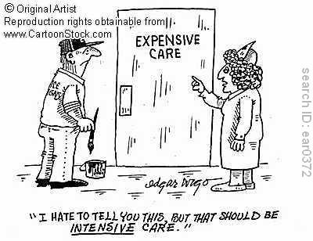

Slide 9
Future Modules
Reasonable body of evidence for RBC transfusion
Consensus based for Plasma, Cryoprecipitate, Platelets
Also cover
cell salvage for trauma and emergency surgery
tranexamic acid in trauma
Awaiting NHMRC approval

Slide 10
Future Modules
Module 5 - Obstetrics
Module 6 - Paediatric/Neonates
Due to commence 2013

Slide 11
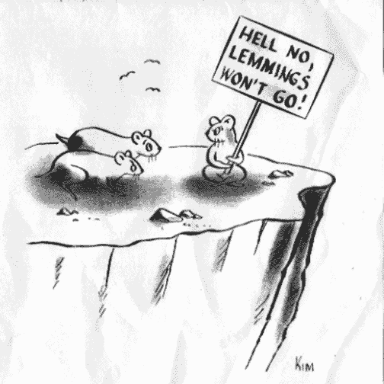

Slide 12
Download or order hard copies from:
www.nba.gov.au

