Slide 1
Daryl Teague
Notes:
Thank you for the opportunity to present this Guideline which has been developed with the Clinical input and expertise of a number of scientific and clinical Colleges and Societies in Australia and New Zealand. I was privileged to be a member of the Clinical/Consumer Reference Group representing the AOA and the surgical perspective, a balance of Science, simplicity, straight forward application.

Slide 2
“I am an orthopaedic surgeon”
My patient’s name is Ruby
She is 73, is in a lot of pain and needs a new hip joint
She has diabetes and high blood pressure
I’ve told her about the surgery
She asked “Will I need a blood transfusion?”
I said “I’m glad you asked that”
“Here is the story about how we will look after you to give you the best care and it’s called
Perioperative Patient Blood Management”
…….The Waiting List becomes the
Preoperative Preparation Period
Notes:
In our every day surgical practice we are faced with a real mortal human, who has a problem, a cry for help, superimposed on their own established co-morbidities, and the solution may require risky intervention. On being informed that this entails the removal of a worn out joint and replacing it with a prosthetic joint, most patients will be concerned about possible complications… death, infection, fracture, Bleeding…. Peri-operative Patient Blood Management

Slide 3
Patient Blood Management (PBM) Program
Notes:
As part of the Pre-Operative assessment we need to review the Patient’s current state of health: identify anaemia, coagulation status (liver, kidney, medications, Nsaids, Clopidogrel, Aspirin, Warfarin, Fish Oil, bleeding history, healing ability). Our surgical anatomical approach should respect vascular intervals, utilise Adrenaline infiltration of the surgical field, control bleeding en passage, and salvage blood along the way.

Slide 4
Implementation of a PBM Program
Develop a collaborative multidisciplinary program
Identify and manage preoperative anaemia
Manage anticoagulant and antiplatelet medication
Adopt multiple intraoperative strategies to minimise blood loss
Tolerance of postoperative anaemia
Notes:
Pre-operative assessment can identify and treat patients with low Hb levels, low iron stores, coagulation inadequacies, co-morbidities that increase risk of blood loss.
Surgical and Anaesthetic planning can minimise operative blood loss, and where it is anticipated blood salvage measures can be initiated peroperatively and postoperatively. And the patient can be advised that a low Hb does not necessarily require blood transfusion, particularly if iron stores are maximized. preoperatively to boost the Hb at the time of operation.

Slide 5
Perioperative Patient Blood Management
Preoperative anemia assessment and management
Intraoperative blood conservation including red blood cell salvage
Postoperative tolerance of anaemia (by transfusion decision support)
Notes:
There are three pillars of Wisdom in Peri-operative patient blood management. Using the waiting list time wisely to maximize the patient’s preoperative fitness; and being surgically prepared to minimize bleeding and salvage blood loss, and post op blood drainage; and to transfuse only where clinically indicated.

Slide 6
Preoperative

Slide 7
Preoperative anaemia assessment
Notes:
There are benefits to patient outcomes. Avoidance of the necessity for transfusion by maximizing pre-operative Hb is beneficial to the patient with decreased morbidity, decreased infection risk, decreased mortality, decreased ICU length of stay, and decreased length of hospital stay.
So, the timing of elective surgery should optimise the patient’s ability to build up preop Iron stores and Hb.

Slide 8
Preoperative haemoglobin assessment and optimisation template
This template¹ is for patients undergoing procedures in which substantial blood loss is anticipated such as cardiac surgery, major orthopaedic, vascular and general surgery. Specific details, including reference ranges and therapies, may need adaptation for local needs, expertise or patient groups.
Preoperative tests
• Full blood count
• Iron studies² including ferritin
• CRP and renal function
Is the patient anaemic?
Hb <130 g/L (male) or
Hb <120 g/L (female)
NO
YES
Ferritin <30 mcg/L^{2,3}
Ferritin 30–100 mcg/L^{2,3}
Ferritin >100 mcg/L
CRP⁴
Raised
Normal
No anaemia: ferritin <100 mcg/L
Consider iron therapy# if anticipated postoperative Hb decrease is ≥30 g/L
Determine cause and need for GI investigations if ferritin is suggestive of iron deficiency <30 mcg/L^{2,3}
Iron deficiency anaemia
Evaluate possible causes based on clinical findings
Discuss with gastroenterologist regarding GI investigations and their timing in relation to surgery³
Commence iron therapy#
Possible iron deficiency
Consider clinical context
Consider haematology advice or, in the presence of chronic kidney disease, renal advice
Discuss with gastroenterologist regarding GI investigations and their timing in relation to surgery³
Commence iron therapy#
Possible anaemia of chronic disease or inflammation, or other cause⁵
Consider clinical context
Review renal function, MCV/MCH and blood film
Check B12/folate levels and reticulocyte count
Check liver and thyroid function
Seek haematology advice or, in the presence of chronic kidney disease, renal advice

Slide 9
Preoperative anaemia management
Notes:
Iron therapy needs Vitamin C to initiate Fe+++ to Fe++ for better absorption. Milk blocks Iron absorption. IV Iron may be indicated. Ferritin is protein bound iron, and low levels infer Iron deficiency.

Slide 10
Intraoperative

Slide 11
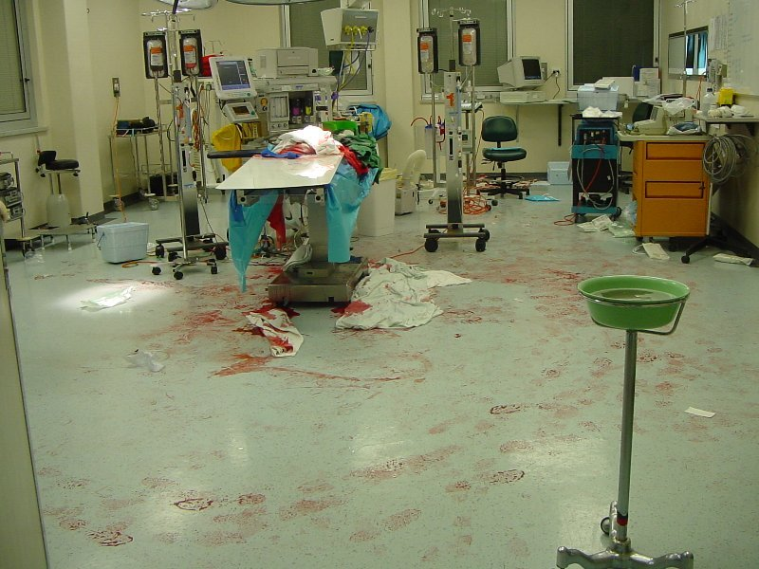
Intraoperative Techniques to reduce blood loss
Notes:
Some times the operating theatre can look like this after a heated discussion between the Surgeon and the Anaesthetist. More commonly it spells a story of major blood loss and all the attendant risks to the patient. What can we do to minimise per-operative blood loss?

Slide 12
Notes:
Surgically anticipated blood loss should trigger immediate mechanisms to minimise blood wastage and maximise blood salvage at the time of surgery.

Slide 13
Intraoperative blood salvage
collection of blood from clean operative field
automated cell saver device / Sangvia
suction salvaged
washed
concentrated
resuspended
Reinfused
Notes:
Primitively in war surgery in the past I have collected bulk blood from a clean body cavity and immediately re-infused the patient.
Today we have more sophisticated options. The Sangvia device can selectively suction blood out of the operative field site, directly in to a storage bag, filtering on route, before being reinfused immediately in to the patient. In more elective circumstances, an automated cell saver with dedicated stand by staff can reinfuse washed, filtered, concentrated, resuspended salvaged blood in to the patient.

Slide 14
Techniques to minimise surgical blood loss : “white linen surgery”
careful planning of actual surgical procedure, taking account of blood conservation
vascular conserving anatomical operative approaches
minimally invasive surgery
limb exsanguination before the application of a tourniquet with Esmarch technique
use of a surgical tourniquet at correct limb occlusion pressure to enable surgeons to work in a bloodless operative field (250 mmHg)
Notes:
Good appreciation of anatomy protects damage to major blood vessels. Minimally invasive approaches can reduce blood loss and morbidity to a fraction of that seen in Open surgery. Removing blood from the operative field by returning it to the body core blood volume with an Esmarch bandage, prior to application of a Tourniquet, prevents blood loss. Pressure limb bandages, and Naropin mediated vasoconstricton, and elimination of drains, can conserve blood.

Slide 15
Electrosurgical diathermy and harmonic scalpel techniques (e.g. argon beam, cavitational ultrasonic surgical aspirator [CUSA])
Use of topical agents (e.g. thrombin, collagen, fibrin glue, tranexamic acid)
“treat every patient as if they were a Jehovah’s Witness”
Notes:
Cutting diathermy, coagulative diathermy, argon beam diathermy, all maintain a better surgical field vision, and minimize blood loss.

Slide 16
Tranexamic acid (intravenous)
Hip Arthroplasty
15 mg/kg at induction (? repeat dose at 8 and 16 hrs postoperatively)
Knee Arthroplasty
15 mg/kg prior to tourniquet release (? repeat dose at 8 and 16 hrs postoperatively)
Cardiac surgery
15 mg/kg at induction, infusion of 4.5 mg/kg/hr intraoperatively (higher doses have been associated with seizures)
Notes:
I use Tranexamic Acid in open hip surgery with good per-operative and post-operative effect, dispensing with the use of post-operative drains to release free blood from the closed wound tissue spaces

Slide 17
Postoperative
Notes:
So what about after the surgery?

Slide 18
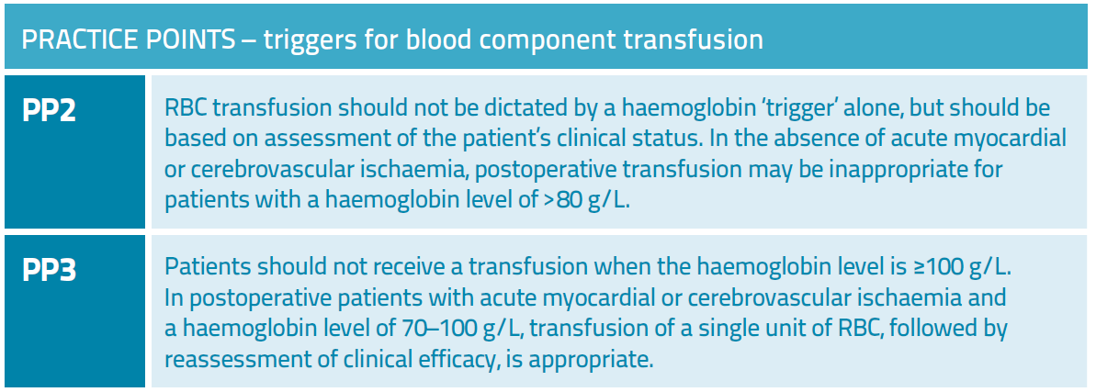
Postoperative transfusion decision support
Notes:
Revised Hb trigger levels have reduced the practice of top up transfusions.
In the healthy patient Hb of 70-100 g/l may well be tolerated, as witnessed in JW patients .
In post-op patients with Myocardial or Cerebral Ischaemia with Hb of 70-100 g/l then a single unit Transfusion with post transfusion reassessment, is appropriate.

Slide 19
Educate all clinicians about THE THREE PILLARS:
“Optimise” preoperative red cell mass
“Minimise” perioperative blood loss
“Optimise” tolerance of postoperative anaemia
Notes:
So it is our responsibility to establish these principles, these three pillars of wisdom, with respect to patient blood management in the peri-operative period, and we will be doing our patient a favour.
Thank you for your attention.

Slide 20
Thank you

