Slide 1
Launch of the Patient Blood Management Guidelines
Professor Chris Baggoley
National Portrait Gallery, Canberra
19 September 2012

Slide 2
Blood - a precious resource
In Australia, 1 in 3 people will need blood sometime in their life but only 1 in 30 donate.
In 2012-13, the Blood Service needs to collect around 1.4 million donations, and this is growing each year.
Blood transfusions are a recognised life-saving part of medical treatment, they can also be associated with adverse events and poorer outcomes for some patient groups. Some evidence suggests that up to 1 in 5 blood transfusions may not have been necessary.

Slide 3
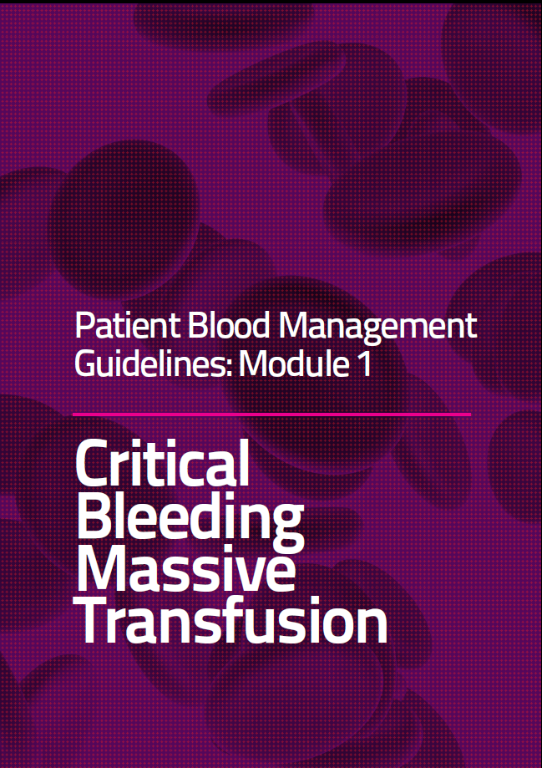
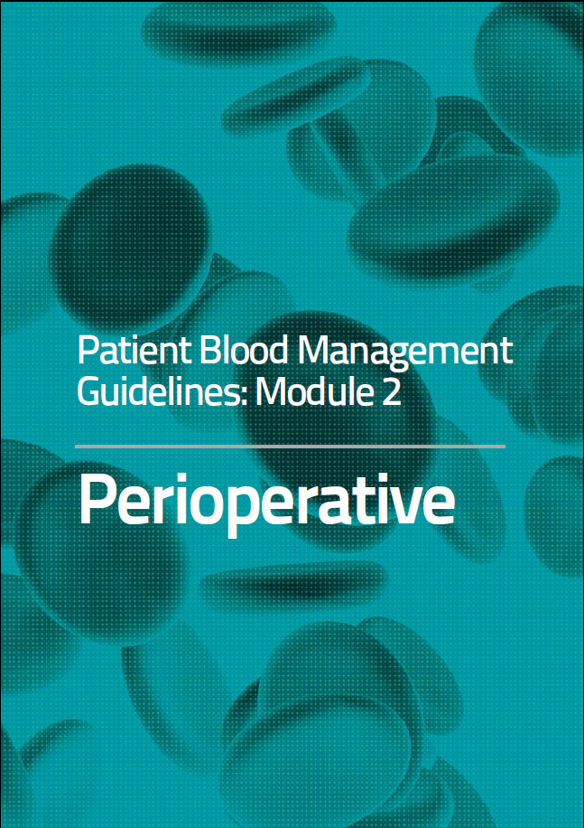
Official launch of the Guidelines

